Slide 1
Topic Proposal
Home Advantage in Football
A presentation by
Anastasia Hildebrandt
Alexander Kens
Raphael Kleemann Sánchez
Florian Six
TU Berlin
WiSe 2021/22
Programming Project:
Data Science in Python and R
Group D
Notes:
Welcome to our Presentation in which we want to propose our topic to you.
In the next few weeks we will be researching on Home Advantage in European football.

Slide 2
TABLE OF CONTENTS
01
Motivation and Background
02
Research Question
03
Datasets
04
Analysis Pipeline
Why is the topic important?
What do we want
to find out?
What are we going to analyse?
What does the data look like and where does it come from?
Notes:
During this presentation though we would like to give you a little background to the topic and a motivation about why it is important to talk about Home Advantage in football.
After that we present to you our research question, formulate a data question on which the actual analysis is going to be done. Of course proper Datasets are needed in order to perform a proper analysis, so we will present our datasets and tell you what we will focus on during our analysis to find a good answer for our question

Slide 3
01
Motivation and Background
What is it all about?
Notes:
So on to motivation, why do we want to talk about Home Advantage and what makes the topic relevant especially now, in today’s time?

Slide 4
Home Advantage
hosting teams have an undoubtedly advantage
Guest teams have some kind of disadvantage
Why do people think that?
Alan M. Nevill and Roger L. Holder - 4 main reasons (1):
Crowd
Learning
Travel
Rule factors
Notes:
Before I answer this question l think I might have to quickly explain the concept of Home advantage to some of you. Home Advantage is a common concept in sports which basically means that the hosting team has an undoubtedly advantage in comparison to the guest team which seems to have some kind of disadvantage.
So why do people think that? Without going too deep into this topic, varying from sport to discipline to competition, the main reasons seem to be always concerning the Crowd, Learning (ability of guest team to cope with the local conditions (different climate, different ground conditin like the turf)), Travel and Rule Factors.
This is also something we want to talk about eventually, how do rules affect the outcome of a game of football?

Slide 5
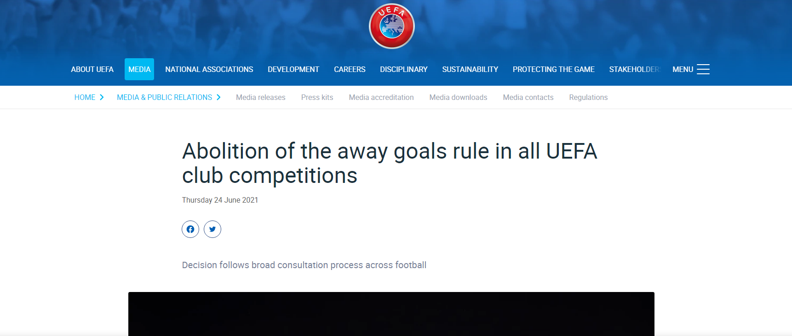
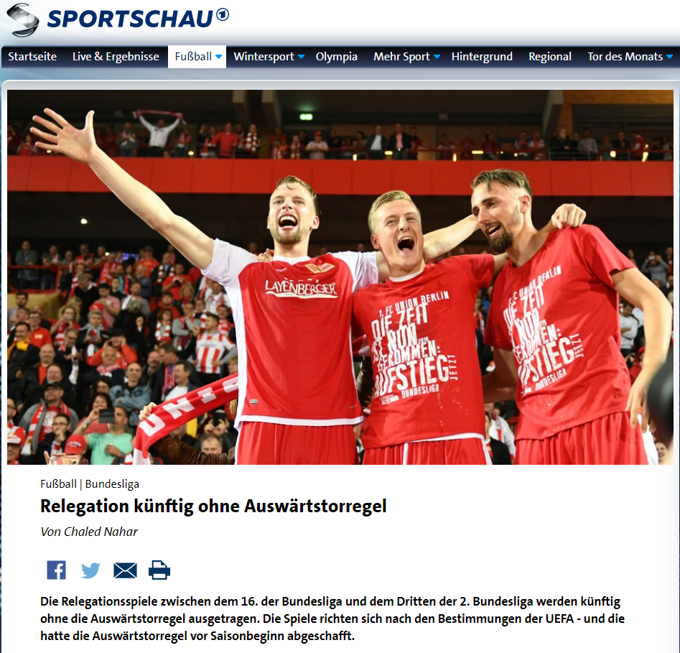
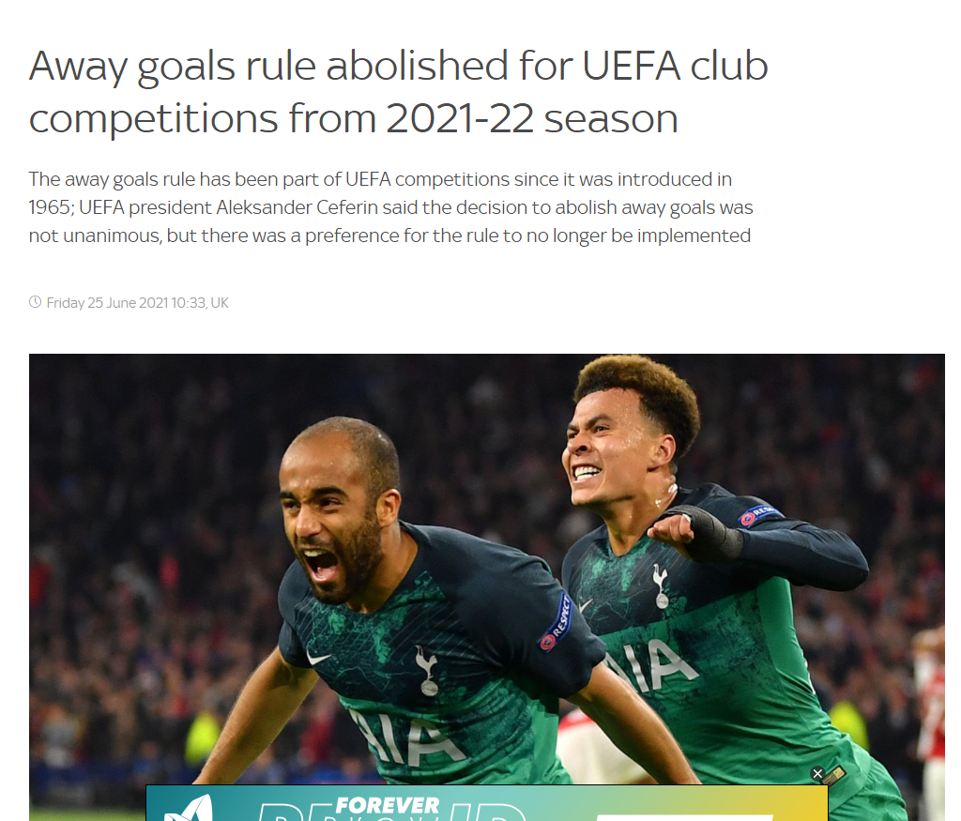
Away goals rule
When 2 teams play each other twice, once at each team’s home ground and it is a tie score wise, the team which scores more ‘away goals’, wins. (4)
tiebreaker
Introduced in 1965 to all UEFA competitions (4)
Champions League, Euro League, etc.
Relegation
Notes:
In football there is the so called Away Goals Rule.
!regel vorlesen!
The introduction of this Rule, was based on the assumption that the hosting team has an advantage in football games.
So, the existence of this rule, should imply that the so called Home Advantage exists right? So why do we want to talk about it now?
Well, last year in 2021 the Away Goals Rule got abolished. Throughout all Competitions.
Which ultimately leads us to our research question

Slide 6
02
Research Question
What do we want to find out?
Notes:
From the theory of psychological and physical (running) benefits for the host(ing) team as
the majority of fans cheering for them
along with the advantage of not having a long approach to the stadium
and the abolishment of the away goals rule this year
we were curious and stated our research question as followed:
[nächste Folie]

Slide 7
Does home advantage exist in professional European football?
Notes:
Does home advantage exist in professional European football?
Operationalisation:
Operationalising this question we can highlight the constructs home advantage and professional eurpean football.
[Nächste folie]

Slide 8
Research Question
Does
Home Advantage
exist in
professional European Football?
I. Construct - Home Advantage
"the consistent finding that home teams in sports competitions win over 50% of the games played under a balanced home and away schedule” (3)
II. Construct - Professional European Football
Countries first leagues: Germany, France, UK, Spain, Italy
UEFA: Champions League, Europe League
Notes:
From the theory of psychological and physical (running) benefits for the host(ing) team as
the majority of fans cheering for them
along with the advantage of not having a long approach to the stadium
and the abolishment of the away goals rule this year
we were curious and stated our research question as followed:
Does home advantage exist in professional European football?
Operationalisation:
Operationalising this question we can highlight the constructs home advantage and professional eurpean football.
Construct 1
In this domain specific context we define home Advantage as mentioned In the review, of Courneya and Carron as
‘the consistent finding that home teams in sports competitions win over 50% of the games played under a balanced home and away schedule’.
Having in mind that balanced is referring to an equal number home and away matches
Construct 2
The construct professional european football will be focus on:
The Countries first leagues from: Germany, France, UK, Spain, Italy
As well as UEFA: Champions League, Europe League
Due to the existend balance of home and away matches..

Slide 9





Data Question
Do host teams win more than 50% of the equal number of home and away matches in the first leagues of Germany, England, Spain, Italy, France and the Champions and Europe League?
Notes:
This leads us to our Data question that arises by inserting our two defined constructs:
“Do hosting teams win more than 50% of the equal number of home and away matches in the first leagues of Germany, England, Spain, Italy, France and the Champions and Europe League?“
In order to answer the data question now we show you the relevant datasets

Slide 10
03
Datasets
What does the data look like?
Notes:
Now that we have the data question we can take a look at the data.

Slide 11
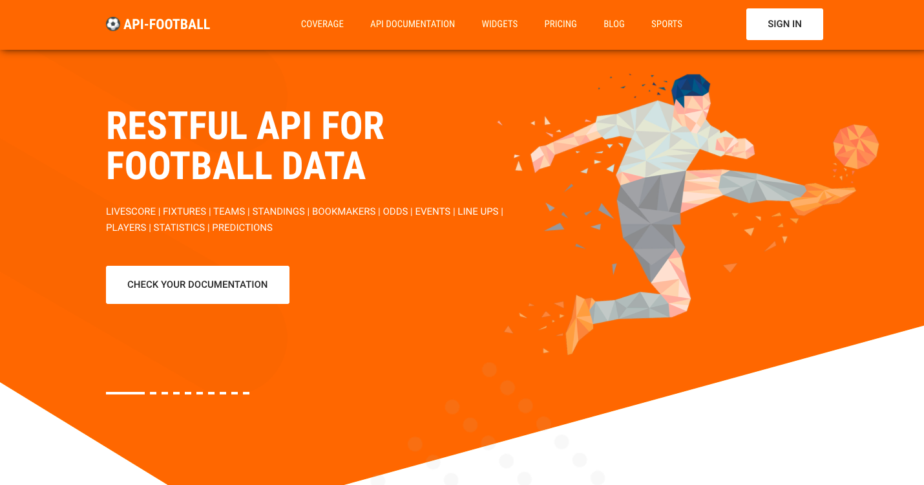
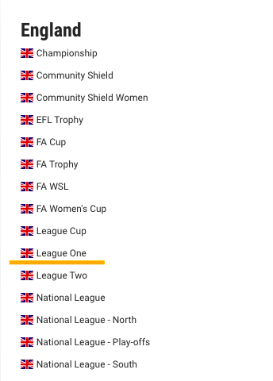
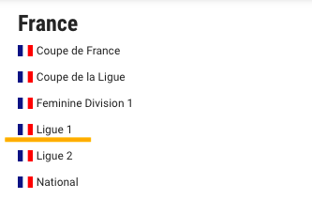
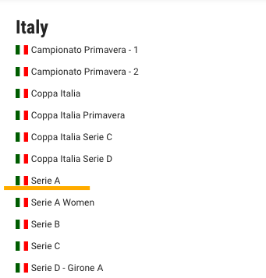
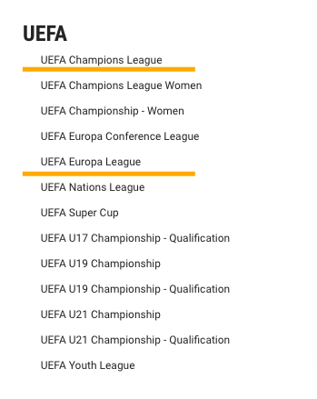
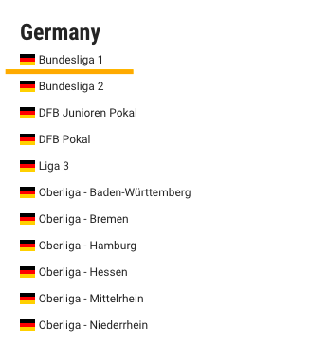
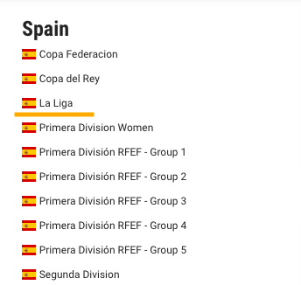
api-football.com
Notes:
We found our Datasets on the website api-football.com.
And their database has 163 countries in 890+ leagues with earliest data from 2008. Now the data for the leagues we have been looking for have data from 2010 on which will suffice for our study.

Slide 12
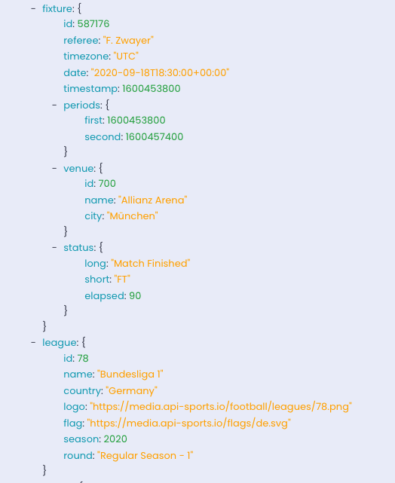
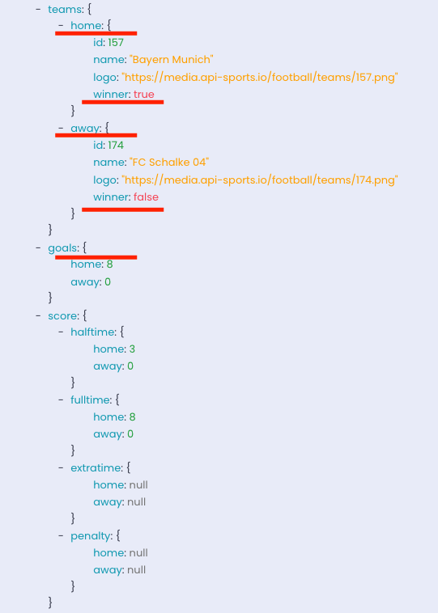

API-Request Fixtures (Matches)
/leagues
/fixtures
Parameters: country, id, name, etc.
"GET", "/{endpoint}?{query1=param1}&{query2=param2}&{...}"
"GET", "/leagues?country=germany”
bundesliga 1 = 78
Parameters: league, season, id, team, etc.
"GET", "/fixtures?league=78&season=2020"
Home, away, winner, goals
Notes:
In order to retrieve our data we do requests.
1) A GET-Request is quite simple. Although a little Python is needed to receive the fixtures, which is just a fancy word for match.
2) First we need the league-id which we get by querying the database and the endpoint /league where we need to ask for the country so we can find the first league of the respective country. 3) With the league-id now, which we need because most endpoints expect an integer for the parameter league, and the year we can retrieve finally the fixtures (single matches) of a league in a single season.
5) A fixture contains a lot information but the important chunks like home- and away-team, winner, loser, goals, are there like you can see.

Slide 13
Processing to clean Data
Bytes
String
JSON
Dataframe
Pandas/R
str = data.decode("utf-8")
data = res.read()
myjson = json.loads(str)
Notes:
Now we come to the transformation process from raw query data to Pandas or R dataframes.
The raw data we receive by queries from the database are in bytes in JSON format. A python class which can be easily decoded into the python String class and from there on into a more structured format the JSON format (a lightweight data-interchange format). The last step is the transition from JSON to a Dataframe what is more complicated and I figured out something for the actual project and not the proposal.
And with dataframes we can actually do some analysis now. Going over to Anastasia.

Slide 14
04
Analysis Pipeline
What are we going to analyse?
Notes:
Now that we’ve seen what our dataset looks like, we need to use that data to answer our research question. So what exactly are we going to analyse?

Slide 15
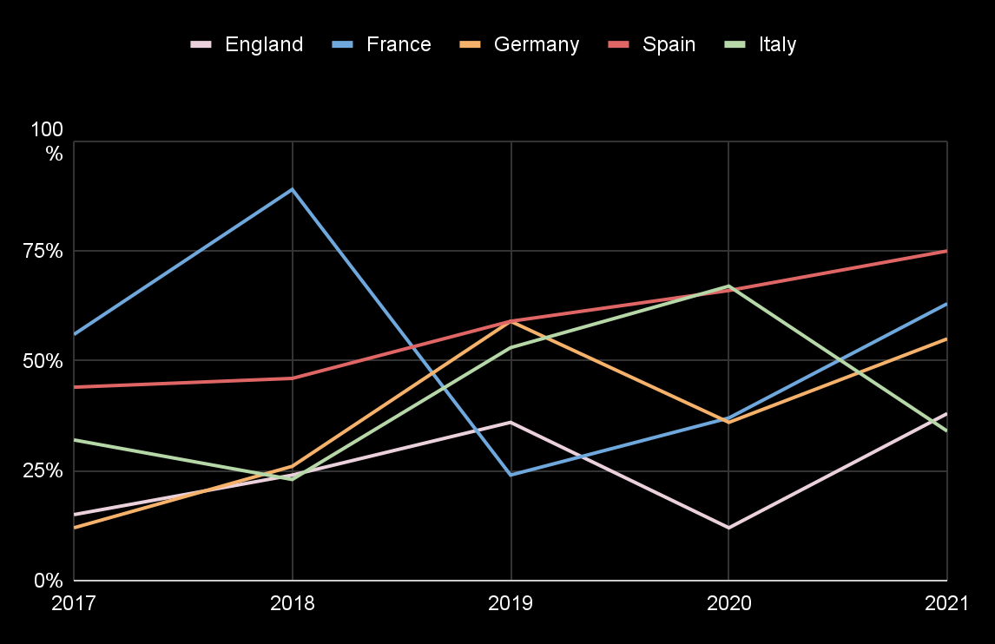
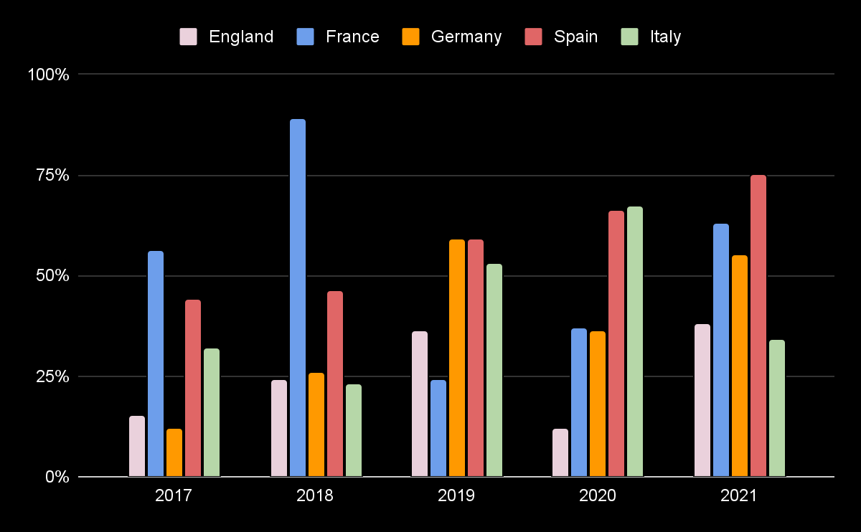
Visualization
Notes:
Here you can see a line and a bar diagramm. This could be an example of how our analysis results could look like. You can see on the x-axis we have the different years where each country had a football game and on the y-axis you can see a percentage. That could stand for how many of the games played has a football team won or how many they have lost… Of course this part is what we are going to do next. But just to give you an idea what it could look like.

Slide 16
Questions
How many games won/lost on avg?
How many goals made/conceded at home/ away?
Are there any strays or is the outcome consistent?
Are the years 2020/2021 different from the years before?
How often did the Away goal rule come into play?
Notes:
We have a couple questions that we hope will help us with our analysis and finding an answer for our research question. For example how many goals has a country/a team made at home or away, are there any strays or is the outcome consistent? Are the years 2020/2021 different from the years before because of covid 19? How often did the away goal rule come into play? And so on

Slide 17
Thank You! Any Questions?
Notes:
And that was our proposal presentation. We hope you liked it. Thank you for your attention and are there any questions so far?

Slide 18
Sources
Papers:
(1) Nevill, A.M. and Holder, R.L., 1999. Home advantage in sport. Sports Medicine, 28(4), pp.221-236.
(2) Leite, W.S., 2017. Home advantage: Comparison between the major European football leagues. Athens Journal of Sports, 4(1), pp.65-74.
(3) Carron, A.V., Loughhead, T.M. and Bray, S.R., 2005. The home advantage in sport competitions: Courneya and Carron's (1992) conceptual framework a decade later. Journal of sports sciences, 23(4), pp.395-407.
Web:
API: https://dashboard.api-football.com
(4) http://www.europapokal.de/champions-league/auswaertstorregel-europapokal-historie-und-abschaffung/
Pictures:
Slide 5:
top right: https://www.uefa.com/returntoplay/news/026a-1298aeb73a7a-5b64cb68d920-1000--abolition-of-the-away-goals-rule-in-all-uefa-club-competitions/
bottom right: https://www.skysports.com/football/news/11095/12340830/away-goals-rule-abolished-for-uefa-competitions-from-2021-22-season
left: https://www.sportschau.de/fussball/bundesliga/dfl-relegation-bundesliga-ohne-auswaertstorregel-100.html
Slide 9:
Club Logos: https://worldvectorlogo.com/
Slide 11:
API Mainpage: https://dashboard.api-football.com
API Coverage: https://www.api-football.com/coverage
Slide 12:
API fixture: https://dashboard.api-football.com/soccer/tester
Pictogramms:
Slide 12:
arrow-right.png: https://www.flaticon.com
- All screenshots and web sources were taken or visited in 26.12.2021

